Slide 1
CH465/565: Physical Biochemistry

Slide 2
Goals for today
Introductions
Plan for the course
Pre-assessment

Slide 3
Mike Harms (he/him)
Call me Mike, Prof Harms, Dr. Harms…
whatever you’re comfortable with.
PhD in biophysics (protein folding)
Postdoc in evolutionary biology
Been professor since 2013.
In my lab, we study how proteins evolve new functions
(evolutionarybiochemist.org)

Slide 4
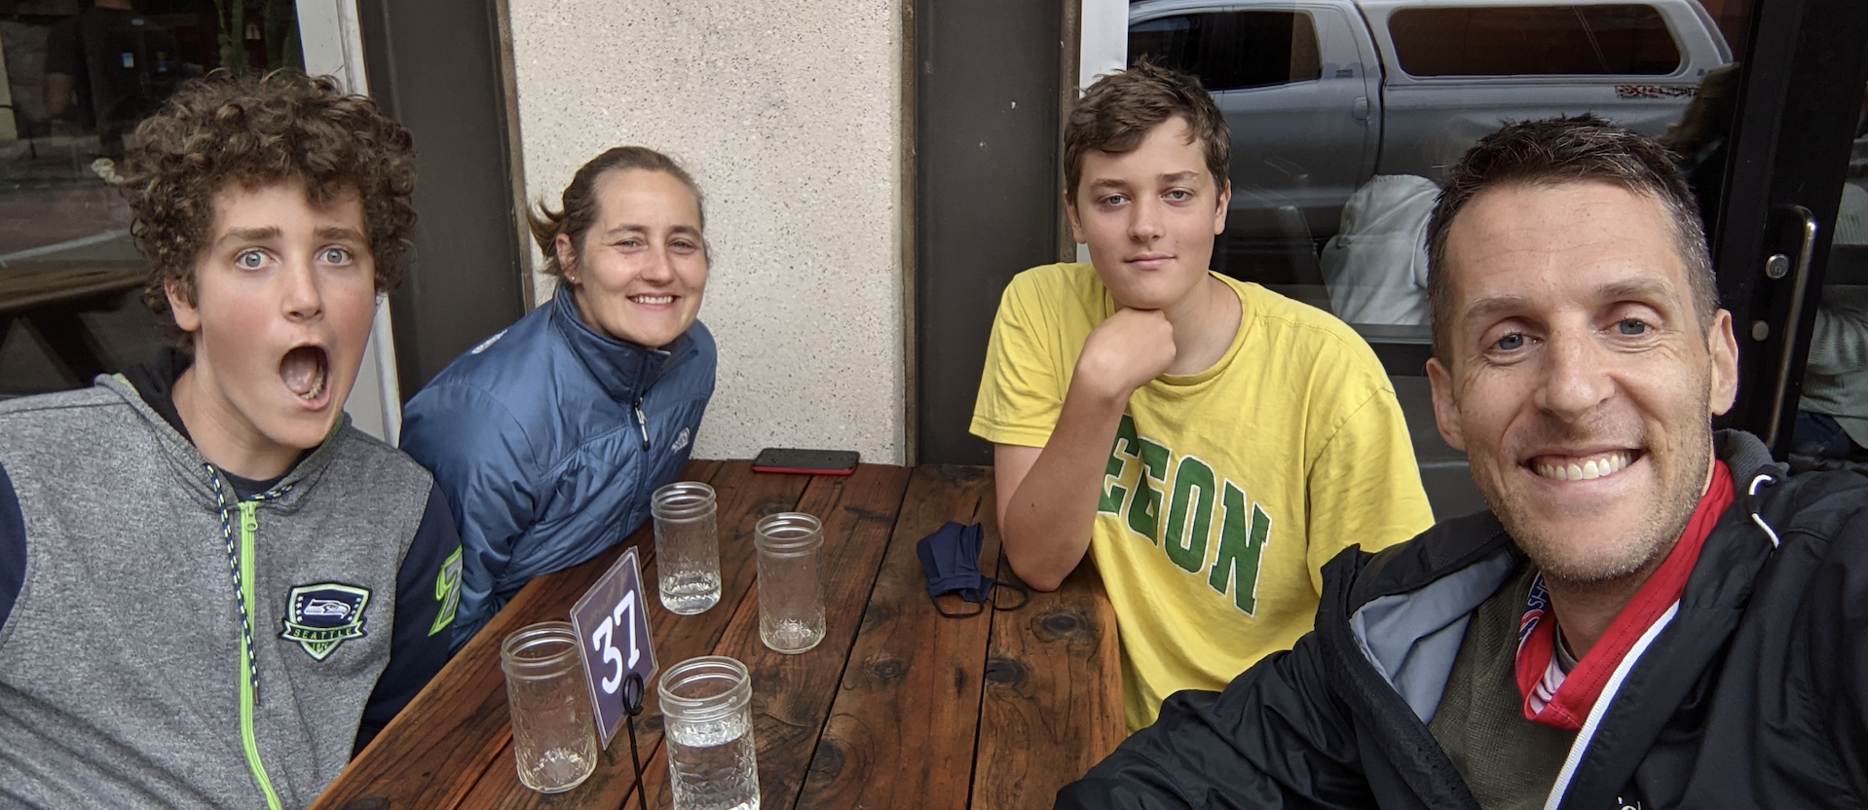


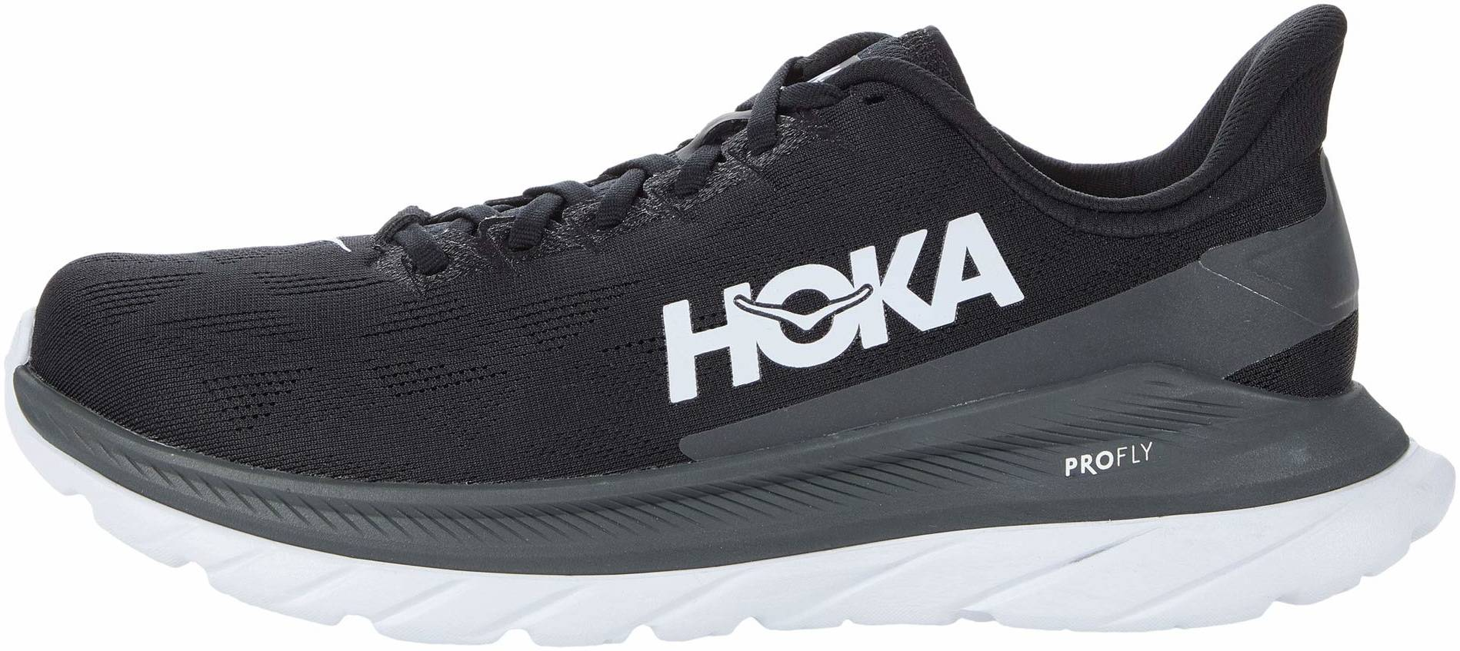

Slide 5
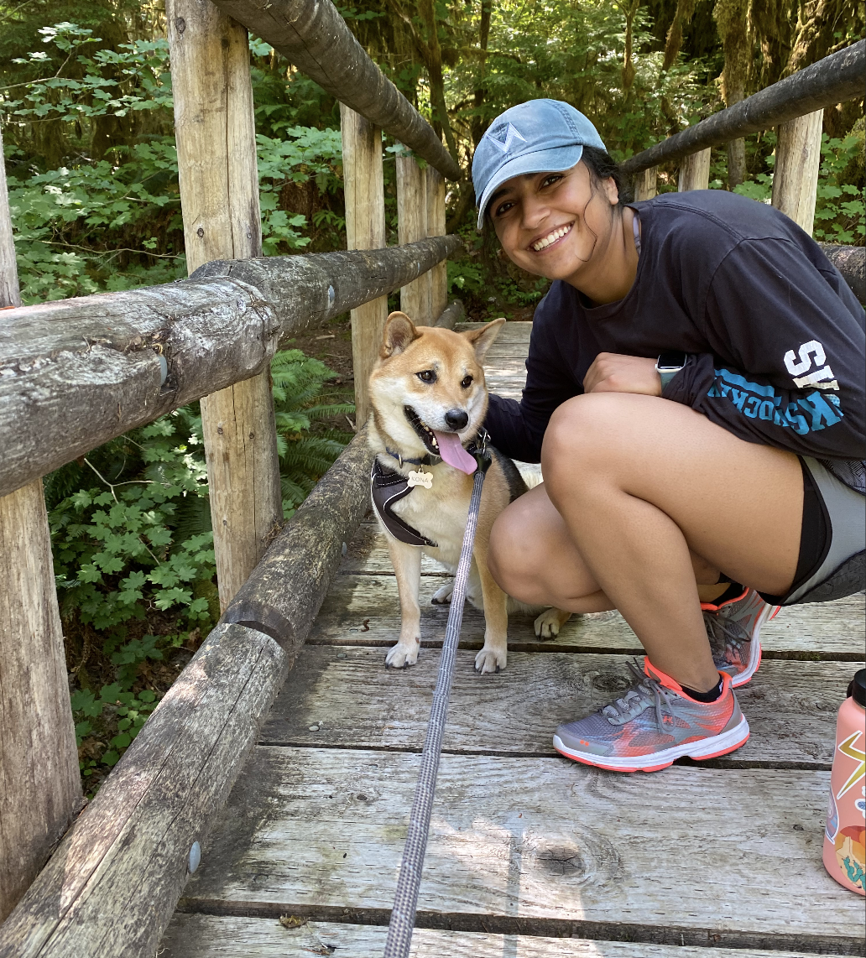
Vandana Reddy
B.S. in Microbiology from Purdue University
M.S. in Bioinformatics from the University of Oregon
Outside of class, I love hiking with the dog, paddle boarding, and watching sports

Slide 6
Who are you?
Name, major, preferred pronouns.
Any research you are doing.
If you had to choose a biomolecule
as your mascot, what would it be?

Slide 7
Goals for today
Introductions
Plan for the course
Pre-assessment

Slide 8
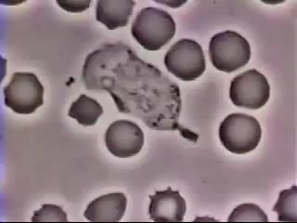
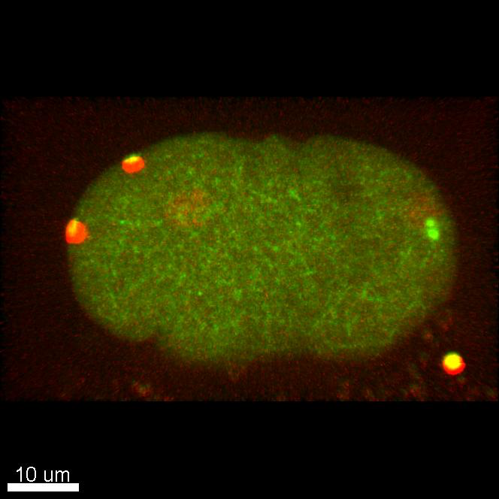
Neutrophil chasing
bacterium
D. Rogers, Vanderbilt
C. elegans cells undergoing mitosis
B. Bowerman, UO

Slide 9
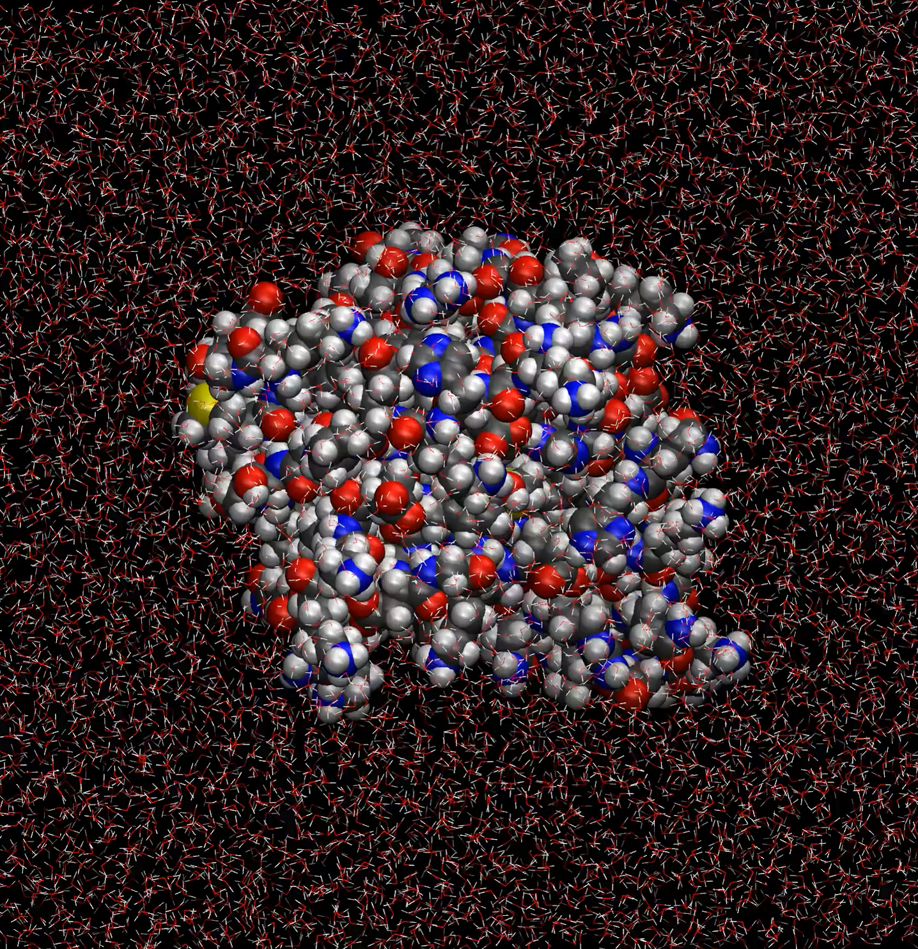

Slide 10
How does biological order arise from stochastic molecules?
How can we learn about molecules too small to see directly?

Slide 11
Main course schedule

Slide 12
Typical schedule
MW: lecture + in-class work
F: in-class projects (bring a laptop)

Slide 13
Summative assessment
How do you want to be assessed?
Traditional exams (midterm/final)
Final project (research proposal or literature review)
Final oral presentations (literature)
Something else?

Slide 14
My personal goal:
That CH465/565 be a place of human thriving.
We learn some very cool biochemistry.
We are a community that supports one another.
Each of us is pushed/inspired to excellence.

Slide 15
Zoom
There will be a zoom session for each class
(linked off canvas schedules).
This session will not be interactive, but you
can tune in if you must miss class.
This session will be recorded, allowing you
to review videos of the lecture.
This is a complement to—not a replacement for—regular
class attendance.

Slide 16
COVID-y stuff
Good Classroom Citizenship
Wear your mask and make sure it fits you well
Stay home if you’re sick. (We will host a zoom session and record each lecture so you can have access to the lecture if you have to miss class).
Get to know your neighbors in class, and let them know if you test positive
Get tested regularly
Watch for signs and symptoms with the daily symptom self-check
Wash your hands frequently or use hand sanitizer
Complete the UO COVID-19 case and contact reporting form if you test positive or are a close contact of someone who tests positive.

Slide 17
Goals for today
Introductions
Plan for the course
Pre-assessment

